Slide 1
Unsupervised Segmentation of Multispectral High-Resolution Images
Kaustuv Ray, Rahul Singh

Slide 2
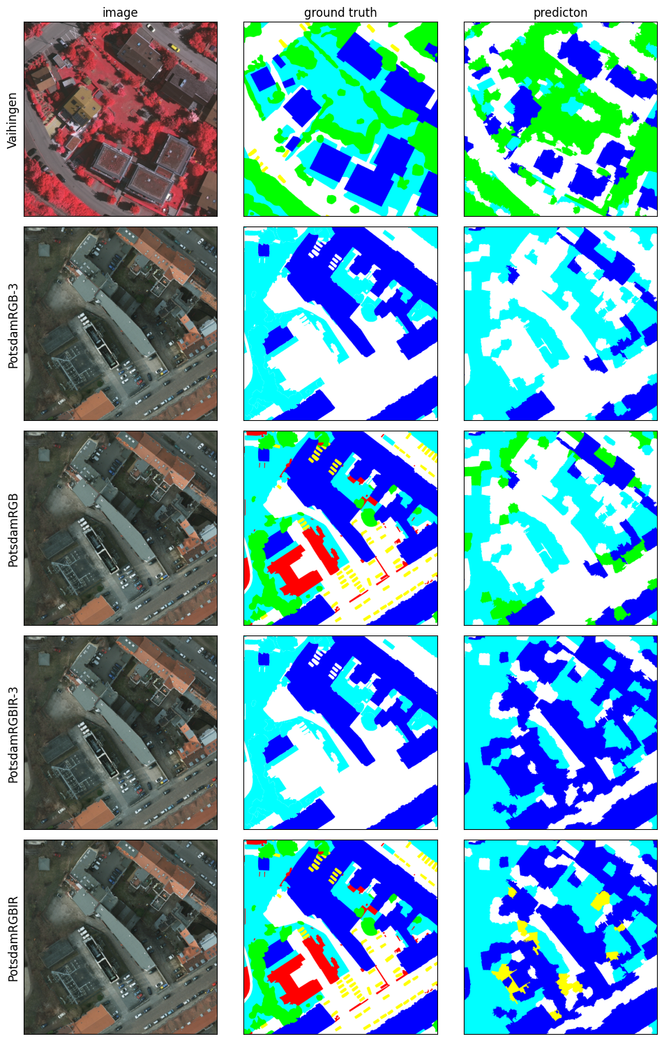
Introduction
Development in satellite images with better spatial, spectral, and temporal resolutions.
The types of images vary with different imaging conditions and satellite sensors.
Notes:
A remarkable development in earth observation instruments has led to the generation of satellite images with improved spatial, spectral, and temporal resolutions.

Slide 3
Introduction
Semantic segmentation is used to partition the image into buildings, roads, vegetation and other categories.
Notes:
Segmentation means partitioning an image into regions based on a predefined task. Semantic segmentation means partition into regions that have a semantic meaning. pre-defined classes such as buildings, roads, vegetation and other categories.

Slide 4
Problem with Supervised Approach
Require large-scale pixelwise annotated dataset, which is time-consuming and costly.
Training data can be limited to a particular geographical location, or weather condition.
New locations will require annotations and models to be trained again.
Thus, these supervised models suffer from domain generalization issues
Notes:
Supervised methods rely heavily on a large-scale pixelwise annotated dataset, but it is time-consuming and laborious to provide manual annotation.

Slide 5
Related Work
Invariant Information clustering(IIC) [1] extends mutual information-based clustering. IIC uses paired samples of an image and its randomly perturbed version. The objective is to maximize the mutual information between the high-level features of the images.
Sudipan et. al.[2] take two views of an image and a third dissimilar image and get the respective dense feature vectors . The loss function uses the pseudo labels, the similarity between the two representations, and the disparity from the dissimilar image.
[1] Xu Ji, Jo˜ao F. Henriques, and Andrea Vedaldi. Invariant Information Clustering for Unsupervised Image Classification and Segmentation. 2019. arXiv: 1807.06653 [cs.CV] [2] Sudipan Saha et al. “Unsupervised Single-Scene Semantic Segmentation for Earth Observation”. In: IEEE Transactions on Geoscience and Remote Sensing (2022).
Notes:
the mutual information (MI) of two random variables quantifies the "amount of information obtained about one random variable by observing the other random variable.
Sudipan et al use dense features. They take an image and its rand transf version as pos sample. Rand img as neg sample. Use pseudo labels as gt. The loss tries to increase

Slide 6
Related Work
InfoSeg[3] leverage both image-level and pixel-level representations for pixel-level segmentation. At each iteration, images are segmented using local and global features and then the mutual information is maximized between local features and global features of their respective class.
STEGO[4] uses a transformer-based architecture. They use features from an unsupervised pre-trained network and try to distill the features into a compact form. They use a (Visual Transformer)ViT backbone and train a shallow network on top it by using contrastive loss between an image, similar images and random images.
[3] Robert Harb and Patrick Kn¨obelreiter. InfoSeg: Unsupervised Semantic Image Segmentation with Mutual Information Maximization. 2021. arXiv: 2110. 03477 [cs.CV]. [4] Mark Hamilton et al. Unsupervised Semantic Segmentation by Distilling Feature Correspondences. 2022
Notes:
Infoseg is similar to iic but they use both global and local features.
Transform based approach. They use an unsupervised pre-trained network and try to distill its features into a compact representation.

Slide 7
Methods
We experiment with two architectures-
Joint Model: Two Fully Convolutional Networks(FCN) sharing the last prediction layer.
Disjoint Model: Two separate FCNs – online and target network. The online network has an additional prediction layer.

Slide 8
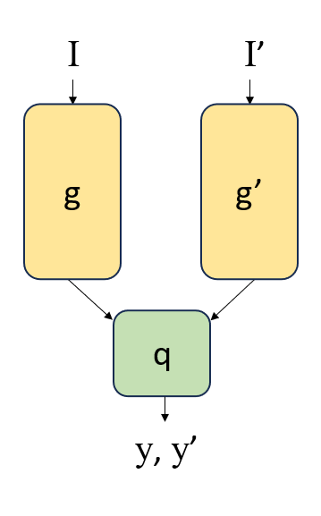
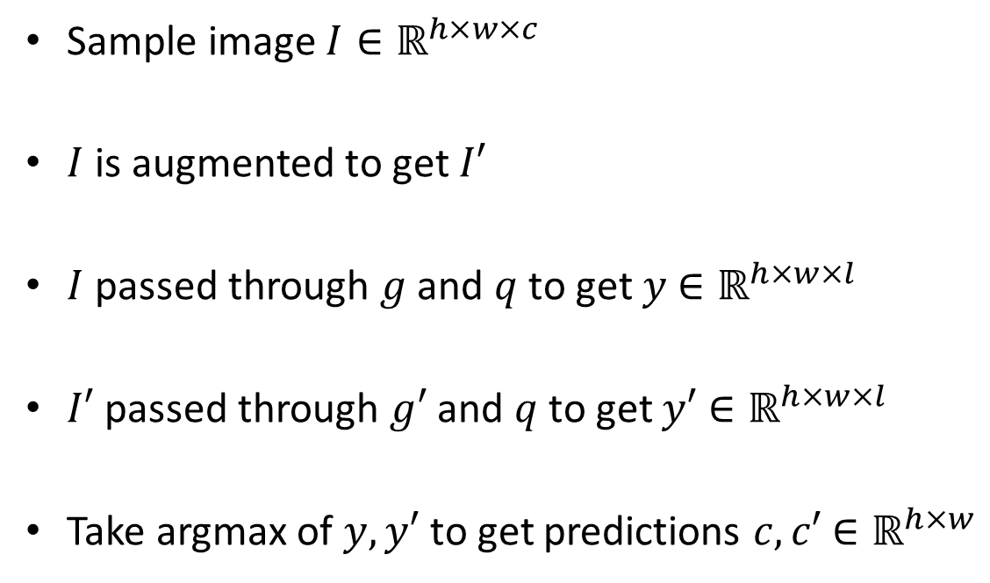
Joint Model
Sample image $I∈ℝ^{h×w×c}$
$I$ is augmented to get $I′$
$I$ passed through $g$ and $q$ to get $y$ $∈ℝ^{h×w×l}$
$I′$passed through $g′$ and $q$ to get $y′$ $∈ℝ^{h×w×l}$
Take argmax of $y,y′$ to get predictions $c,c′$ $∈ℝ^{h×w}$
Notes:
On the right we can see that the model has two fcns g and g’ and share the last layer q.
Y, y’ are dense representations of image. Each pixel has a feature vector associatied with it. We can take the argmax of feat vector to get the prediction for the class.

Slide 9
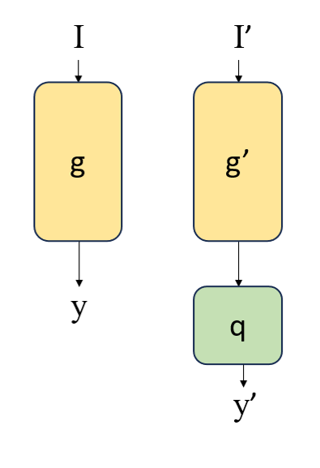
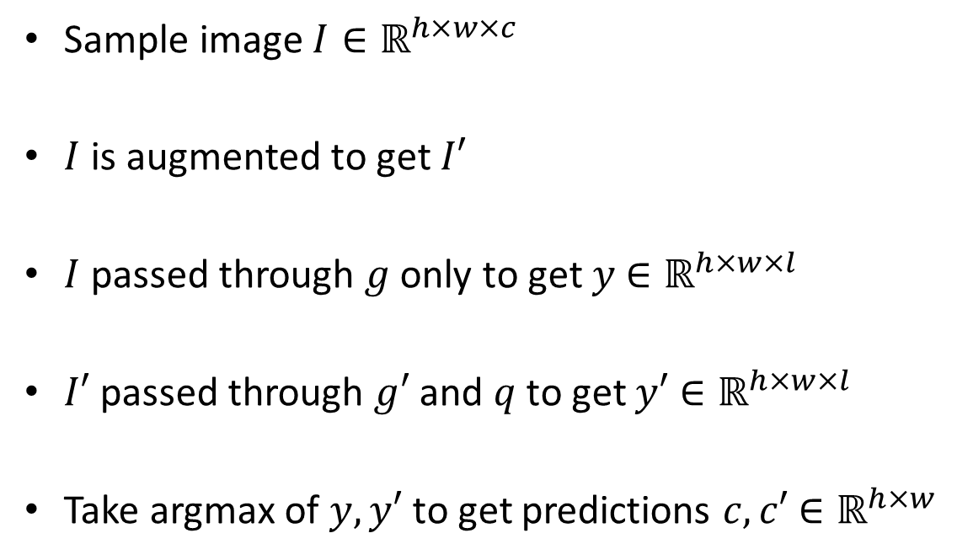
Disjoint Model
Sample image $I∈ℝ^{h×w×c}$
$I$ is augmented to get $I′$
$I$ passed through $g$ only to get $y$ $∈ℝ^{h×w×l}$
$I′$passed through $g′$ and $q$ to get $y′$ $∈ℝ^{h×w×l}$
Take argmax of $y,y′$ to get predictions $c,c′$ $∈ℝ^{h×w}$
Notes:
Y, y’ are dense representations of image. Each pixel has a feature vector associatied with it. We can take the argmax of feat vector to get the prediction for the class.

Slide 10
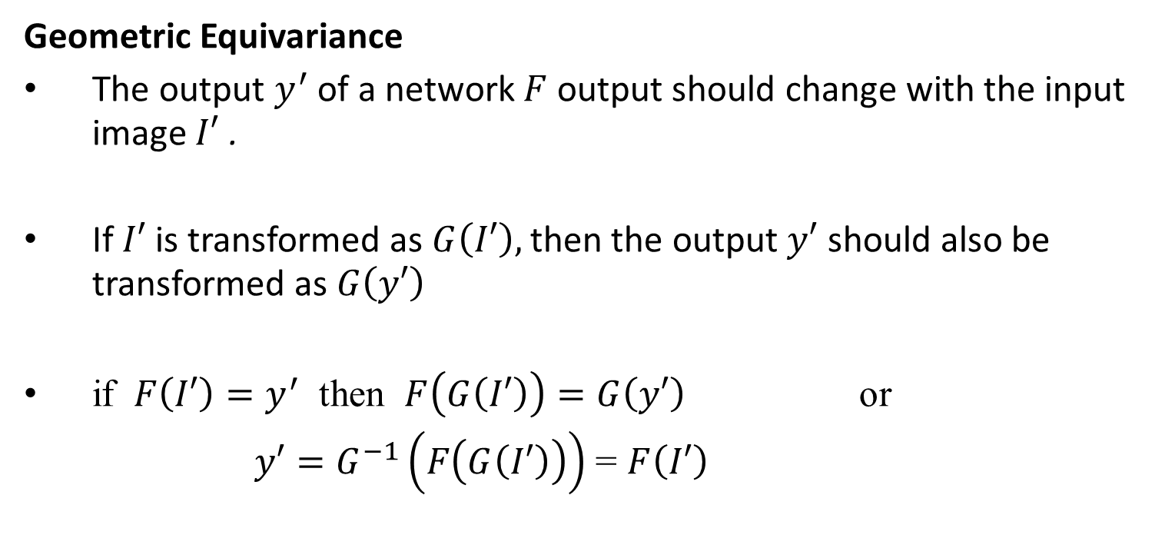
Training Objective
Geometric Equivariance
The output $y^{′}$ of a network $F$ output should change with the input image $I′$ .
If $I′$ is transformed as $G\left(I′\right),$then the output $y′$ should also be transformed as $G\left(y′\right)$
if $F\left(I′\right)=y^{′}$ then $F\left(G\left(I′\right)\right)=G\left(y′\right)$ or
$y′=G^{−1}\left(F\left(G\left(I′\right)\right)\right)$ = $F\left(I′\right)$
Notes:
Geo equiv means that the outpt of network should change with the input if we apply a geometric transform on it.

Slide 11
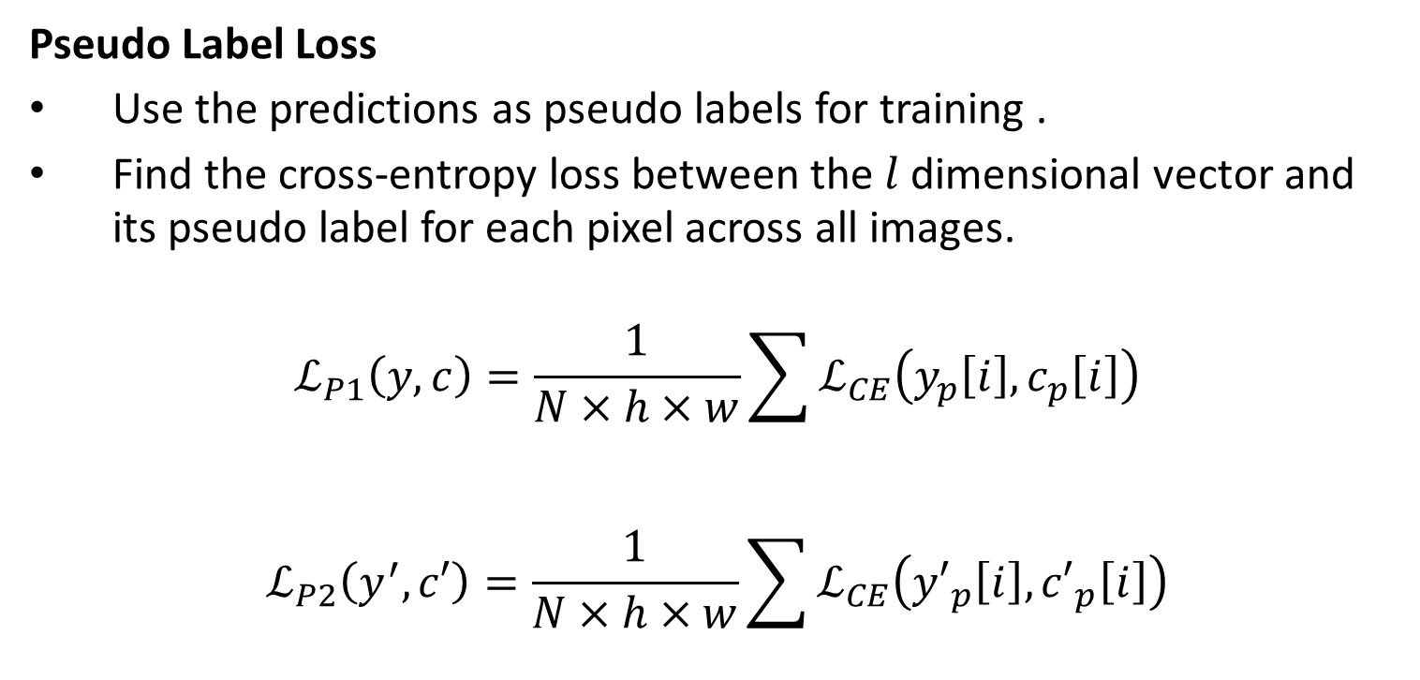
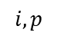
Training Objective
Pseudo Label Loss
Use the predictions as pseudo labels for training .
Find the cross-entropy loss between the $l$ dimensional vector and its pseudo label for each pixel across all images.
$$ℒ_{P1}\left(y, c\right)=\frac{1}{N×h×w}\sum{ℒ_{CE}\left(y_{p}\left[ⅈ\right],c_{p}\left[ⅈ\right]\right)}$$
$$ℒ_{P2}\left(y^{′}, c′\right)=\frac{1}{N×h×w}\sum{ℒ_{CE}\left({y′}_{p}\left[ⅈ\right],{c′}_{p}\left[ⅈ\right]\right)}$$
$$i,p$$
$$i,p$$
Notes:
Since this is an unsupervised setting, we cannot use the ground truth.
Instead, we consider the outputs of the network as pseudo labels and use them for training.
We take the cross entropy loss between the l dimensional vector and its pseudo label.
We find the mean loss over all pixels in the image, and over all images in the batch.
We calculate this mean crossentropy loss for both streams of the network.

Slide 12
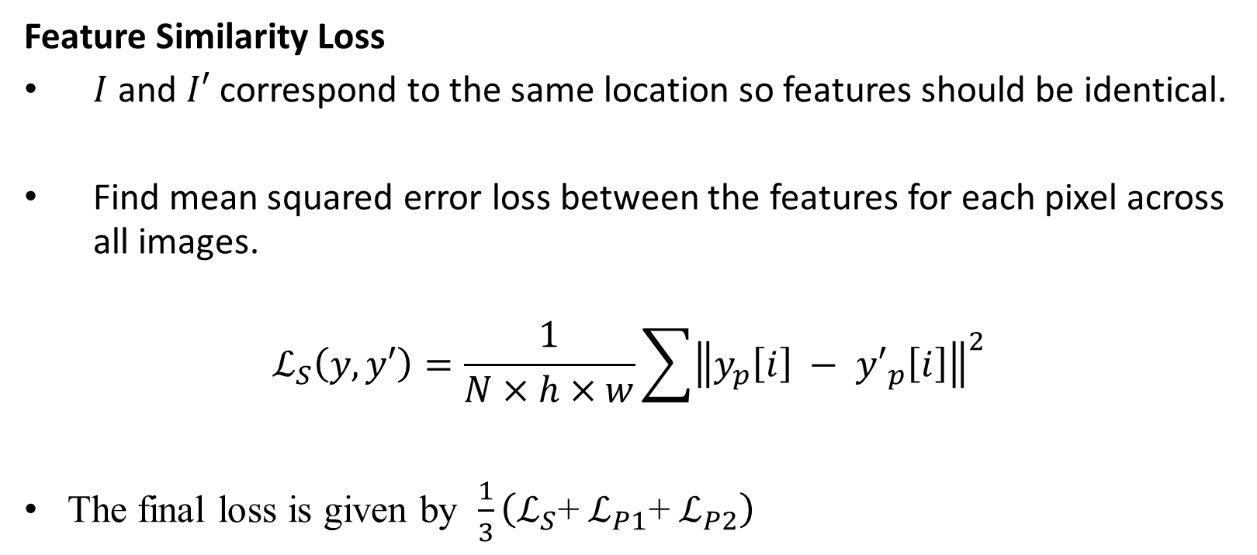
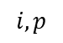
Training Objective
Feature Similarity Loss
$I$ and $I′$ correspond to the same location so features should be identical.
Find mean squared error loss between the features for each pixel across all images.
$$ℒ_{S}\left(y, y′\right)=\frac{1}{N×h×w}\sum{{\left\|y_{p}\left[ⅈ\right] − {y′}_{p}\left[ⅈ\right]\right\|}^{2}}$$
The final loss is given by $\frac{1}{3}\left(ℒ_{S}\text{+} ℒ_{P1}\text{+} ℒ_{P2}\right)$
$$i,p$$
Notes:
I′ and I are the same images but with some random photometric transformation.
They both correspond to the same location, so their features should be identical.
We take the mean squared error between the features for each pixel in an image.
Then we take the mean loss over all pixels in an image and all images in a batch.

Slide 13
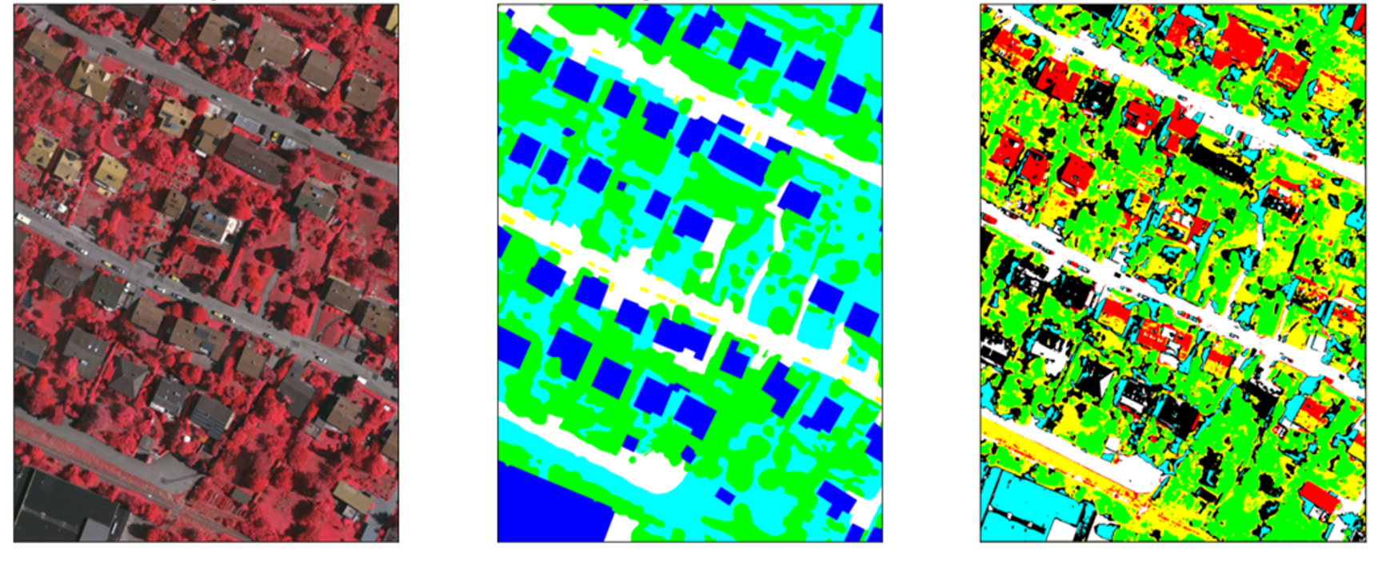
Mapping segments to labels
How to map output segments to labels?
image
output
ground truth
Notes:
In a unsupervised setting the network cannot find the semantic class of a pixel, i.e., it cannot give the class name.
It can only differentiate between different classes
. So we need a method(Fig 4.3) to map the output segments to class labels.
For example in the image both the red class and black class are similar to blue, so we map them to blue
While mapping function uses ground truth labels, the mappings obtained are not used to train the network.

Slide 14
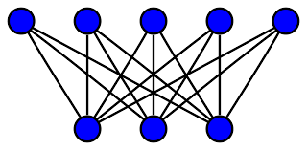
Mapping Functions
Previous methods use Linear Assignment algorithm or match according to highest overlap.
The output classes and labels are the nodes in a bipartite graph. The edges denote the area of overlap.
Linear Assignment finds a matching between the nodes, in which the sum of weights of the edges is minimum.
labels
outputs
Notes:
The assignment problem is a fundamental combinatorial optimization problem
The assignment problem consists of finding, in a weighted bipartite graph, a matching of a given size, in which the sum of weights of the edges is minimum.
Consider the output classes and labels as the nodes in a bipartite graph. The weights denote the area of overlap.

Slide 15

Mapping Functions
Our approach
For each output segment, go through all labels.
Find the intersection over union(IoU) between the segment and label.
The segment is assigned the label with the highest IoU.
Notes:
The assignment problem is a fundamental combinatorial optimization problem
The assignment problem consists of finding, in a weighted bipartite graph, a matching of a given size, in which the sum of weights of the edges is minimum.
Consider the output classes and labels as the nodes in a bipartite graph. The weights denote the area of overlap.

Slide 16
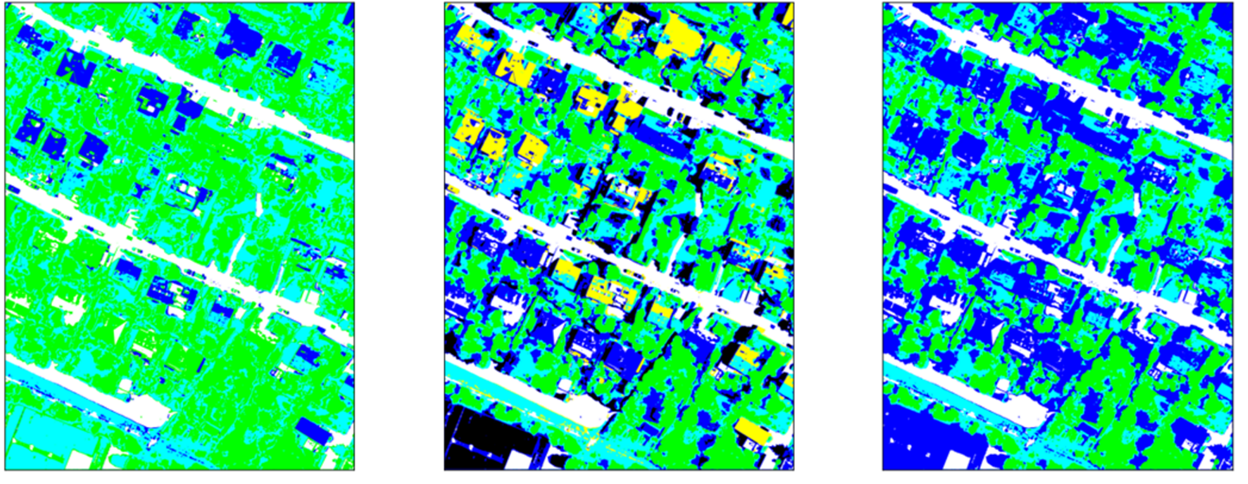
Mapping segments to labels
Predictions
Ground truth
Mapped segments
Notes:
Red and black mapped to blue

Slide 17
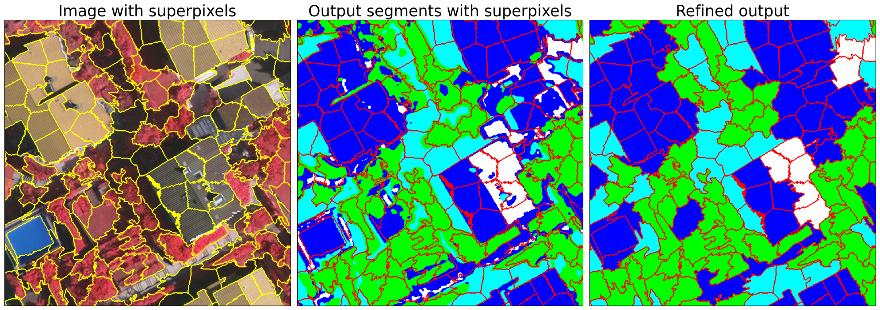
Postprocessing
We don’t want noisy and irregular predictions.
Pixels that look similar and are close to each other should have similar labels.
Superpixels partition the image pixels based on color and position.
Superpixel boundaries also align better with the edges and corners present in an image.
Notes:
We want neighboring pixels to have the same class label.
Superpixels partition the image into multiple segments that have similar color values.
The boundaries of superpixels also align better with the edges and corners present in an image.

Slide 18
Superpixel Correction
We use SLIC algorithm to obtain the superpixels.
Each superpixel is assigned the most frequent cluster label.
image
output
Superpixel correction
Notes:
The SLIC algorithm is used for segmentation based on the similarity of LAB color and spatial distance x y coordinates.
It preforms k-means clustering in this 5 dimensional space.
Its advantages of short time consumption, uniform size of superpixel block

Slide 19
Datasets
We used two urban datasets - Vaihingen and Potsdam.
There are 6 classes - impervious surfaces, buildings, low vegetation, trees, cars, and background.
Potsdam
Vaihingen
Notes:
We used images from two cities – Vaihingen and Potsdam, both areas covering urban scenes.
The ground truth has six classes- Impervious surfaces, buildings, low vegetation, trees, cars, and background

Slide 20
Datasets
We can combine above classes into impervious surfaces, buildings, vegetation to get a 3-class variant of dataset.
 | Vaihingen | Potsdam
Number of scenes | 33 | 38
Scene size | 2500×2000 (average) | 6000×6000
ground sampling distance | 9cm | 5cm
channels | NIR,R,G | R,G,B and R,G,B,IR

Slide 21
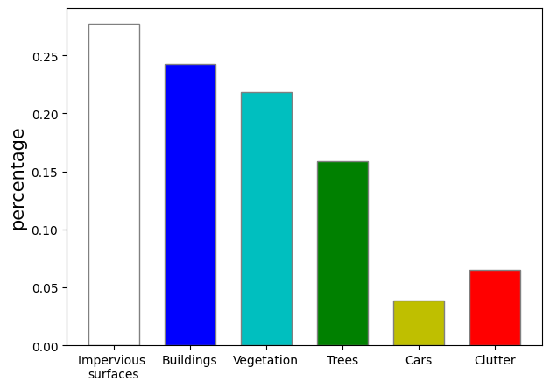
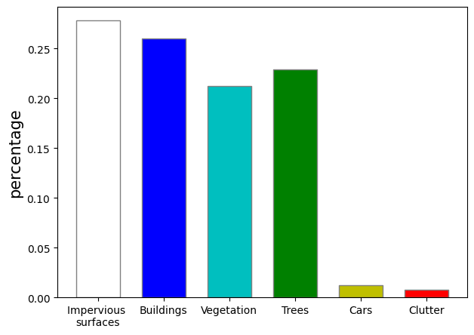
Datasets - Class Distribution
Potsdam
Vaihingen
Notes:
We see that the datasets have class imbalance

Slide 22
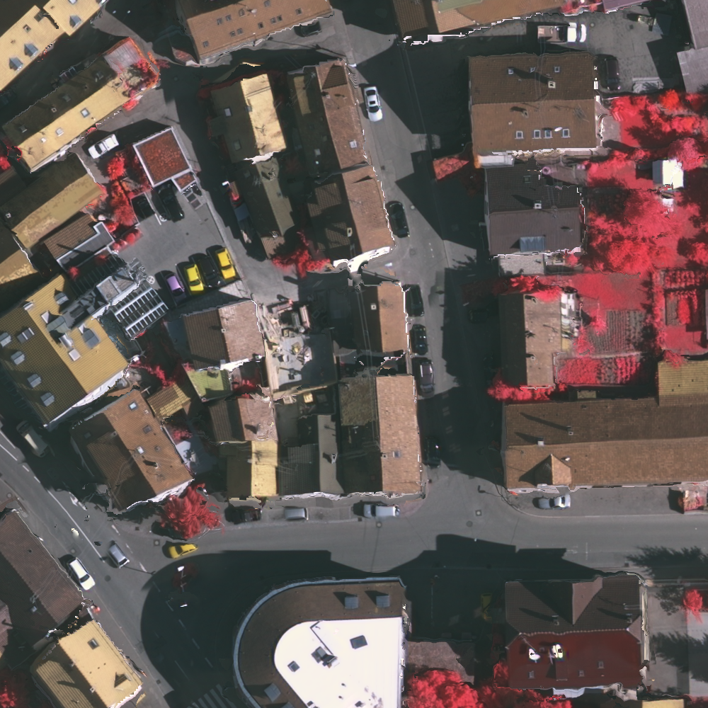
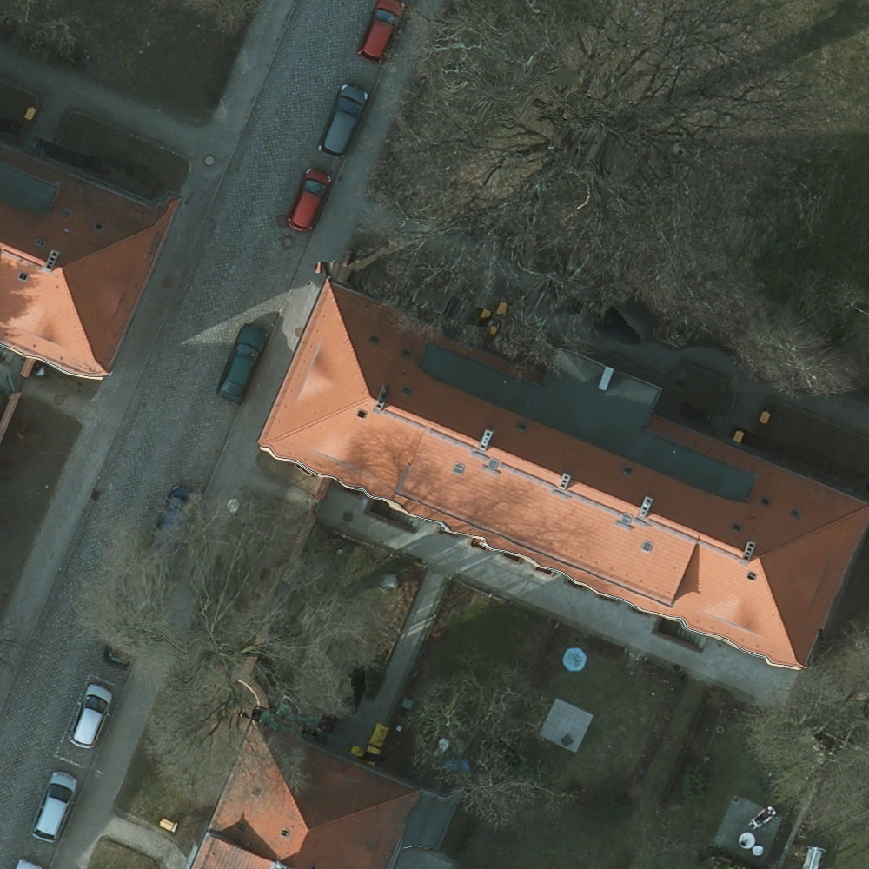
Training - Image Preprocessing
We divided the scenes into 448 x 448 patches.
We scaled Potsdam images by a factor of 0.448 to match the resolution of Vaihingen.
Vaihingen 1000x1000
Potsdam 1000x1000
Notes:
Have diff ground sampling distance
Best way to see the difference in resolution is to compare the size of cars

Slide 23
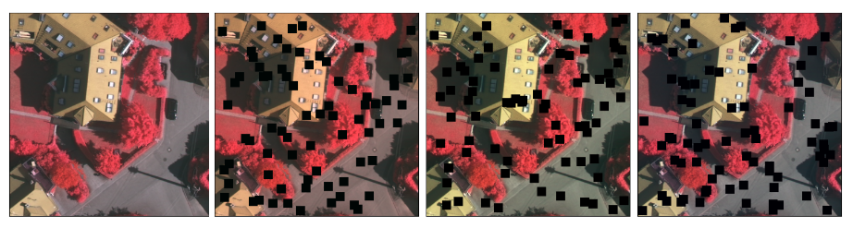
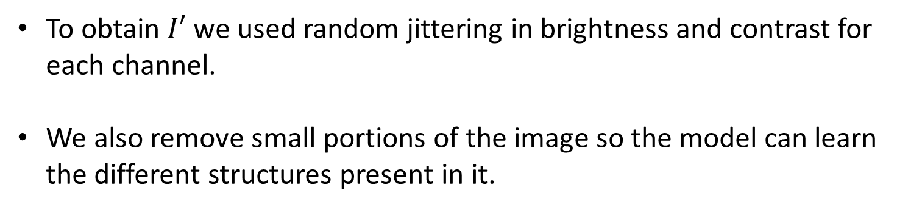
Training - Image Augmentations
To obtain $I′$ we used random jittering in brightness and contrast for each channel.
We also remove small portions of the image so the model can learn the different structures present in it.
original image
Random jittering and removing 20x20 size patches in random locations
Notes:
As we use datasets with multi-spectral images, we require augmentations that are independent of the number of channels. We also blackout small portions of the image, so that the model can learn the structures present in the image. We remove N square patches of side p × p. We have taken N = 70 and p = 20.

Slide 24
Training - Hyperparameters
All networks are initialized using He initialization.
For the joint network we used SGD optimizer with a learning rate of 0.001 and momentum of 0.9, and L2 regularizer with parameter 0.001.
For the disjoint network we used SGD optimizer and momentum of 0.9. We used a learning rate of 0.001 for the online network and 0.002 for the target network.
We train both the networks for 4 epochs.
Notes:
The weights are sampled from a Gaussian distribution with zero mean and a variance of 2fan_infan_in2​.
provides better initialization for ReLU-based networks.

Slide 25
Results
We use mean intersection over union(mIoU) and accuracy for evaluating the models.
In unbalanced datasets good accuracy does not always indicate good performance.
We compare Joint and Disjoint models with Sudipan et. al., IIC, InfoSeg and STEGO.
Notes:
and the network can get a good accuracy by simply learning a single class

Slide 26
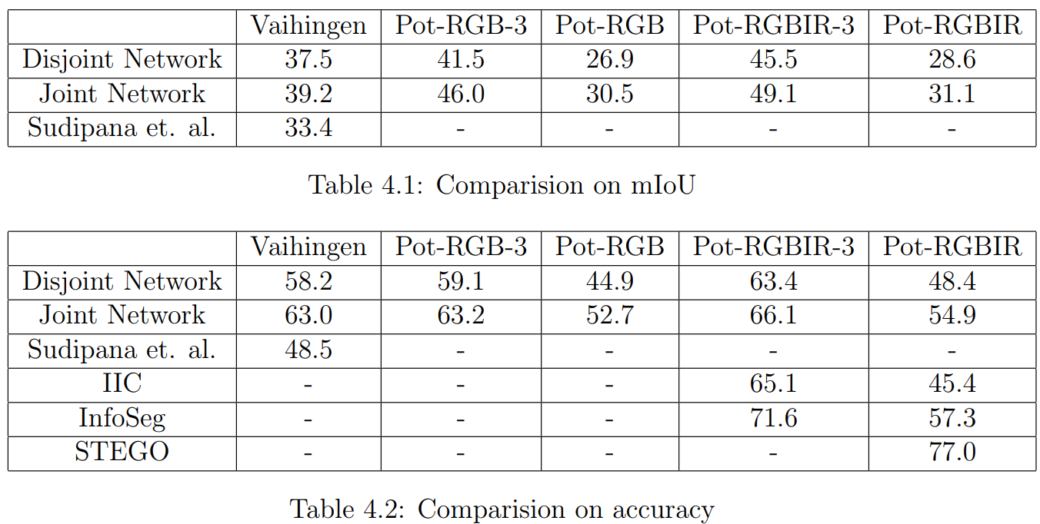
Results - mIoU
Both our models outperform Sudipan et. al.
The Joint Network performs better than the Disjoint across all datasets.
Training on more channels improves mIoU.
Notes:
Sudipan is the only paper that gives the results in mIoU for Vaihingen.
mIoU for other datasets is not available.
Both our models perform better than sudipan
Compare the the Potsdam dataset for diff channels having more channels leads to better segmentation results

Slide 27
Results - accuracy
STEGO gives the best accuracy in Potsdam RGBIR.
The Joint model performs better than Sudipan et. al. and IIC.
The Joint Network performs better than the Disjoint across all datasets.
Training on more channels improves accuraccy.
Notes:
There is not a lot of data for comparison.
For Vaihingen only sudipan gives accuracy.IIC, stego and infoseg give results for PotRGBIR only.

Slide 28
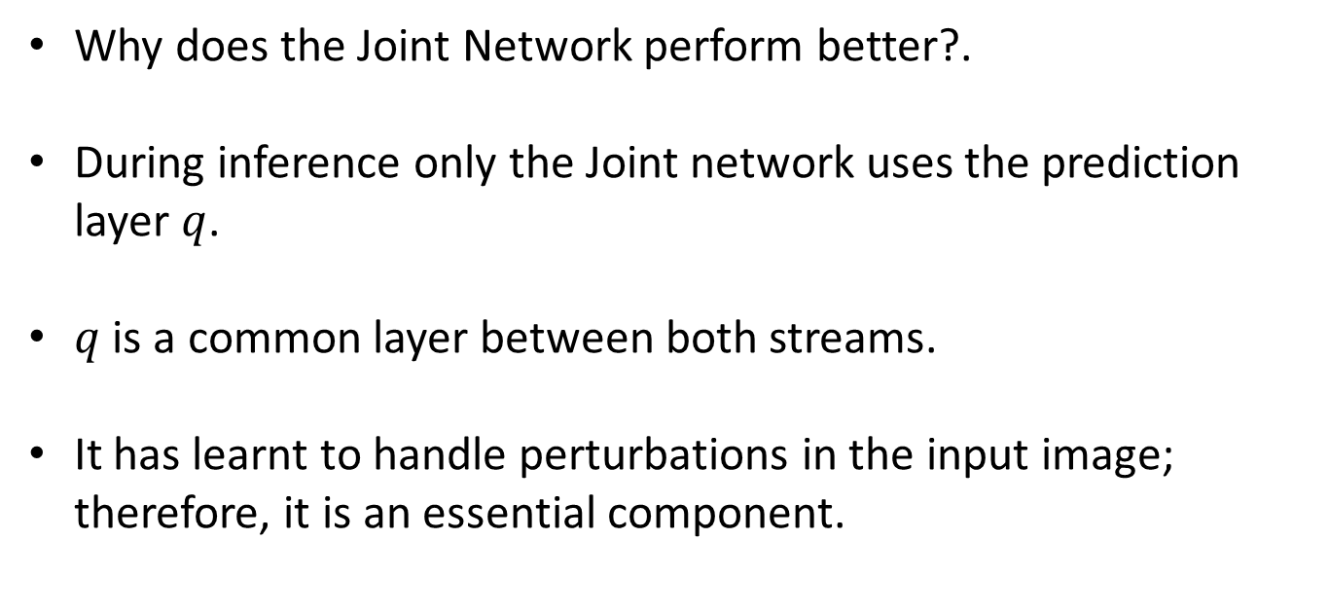
Results
Why does the Joint Network perform better?.
During inference only the Joint network uses the prediction layer $q$.
$q$ is a common layer between both streams.
It has learnt to handle perturbations in the input image; therefore, it is an essential component.
Notes:
We observed that the Joint Network performs better than the Disjoint Network.

Slide 29
Results - Vaihingen
Buildings with multiple colours are not segmented entirely.
Our model is biased towards colour.
image
ground truth
output
Notes:
If we look at the bottom two buildings, they are not segmented properly as they have different colours, which is similar to the roads. Areas in shadow are classified as roads. So we can conclude that the Model is biased towards colour.

Slide 30
Results - Potsdam 3
image
ground truth
output
RGB
RGBIR
Notes:
RGBIR captures more area than RGB

Slide 31
Results – Potsdam 6
image
ground truth
output
RGB
RGBIR
Notes:
I would like to high light some issues in the ground truths.
Red areas refer to clutter, here clutter can be easily mistaken for buildings even for a human. Potsdam also has a high amount of clutter, which affects the metrics.

Slide 32
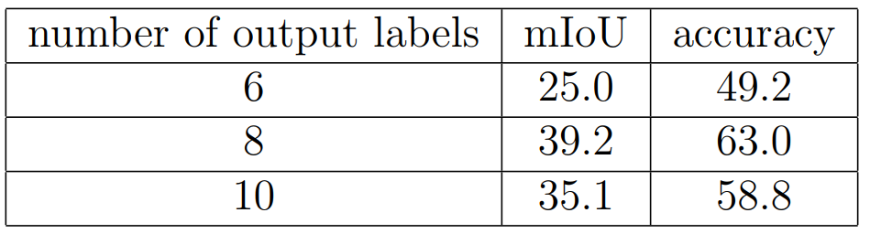
Oversegmentation
We experiment with different numbers of output classes on the Vaihingen dataset using the Joint model.
The best mIoU is achieved with 8 output classes.
More classes is beneficial as model cannot learn the individual classes without labels.
Notes:
We experiment with different numbers of output classes on the joint model.
having more segments is quite beneficial.
This is because the model cannot exactly identify the semantic classes.
By oversegmenting some the mistakes made by the model are rectified. Increasing the output labels beyond 8 affects the performance negatively

Slide 33
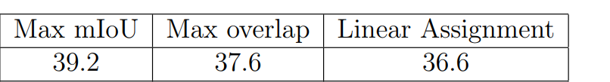
Comparing Mapping functions
We experiment with different mapping functions on the Vaihingen dataset using the Joint model.
Our method gives better results than other mapping functions.
Notes:
having more segments is beneficial. This is because the model cannot exactly identify the semantic classes. By oversegmenting some the mistakes made by the model are rectified.

Slide 34
Comparing Mapping functions
Ground truth
Overlap matching
Linear Assignment
IoU matching
Notes:
Overlap mapping assigned most classes to the majority class.
Does not consider class imbalance.

Slide 35
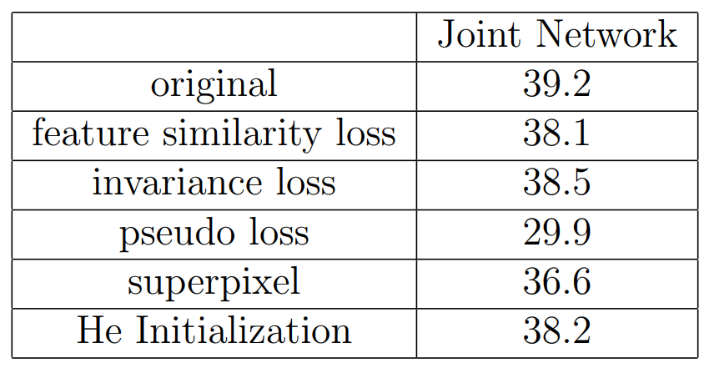
Ablation Studies
Pseudo label loss has the highest contribution to the mIoU.
Superpixel improves the mIoU by a considerable amount.
All other components lead to small improvements.
Notes:
We perform the following ablation studies on the Joint model to understand the contribution of individual components.
We want the contributions of the individual terms of the loss function, and straigtaway we see that removing pseudo loss reduces the mIoU by 10 pts.

Slide 36
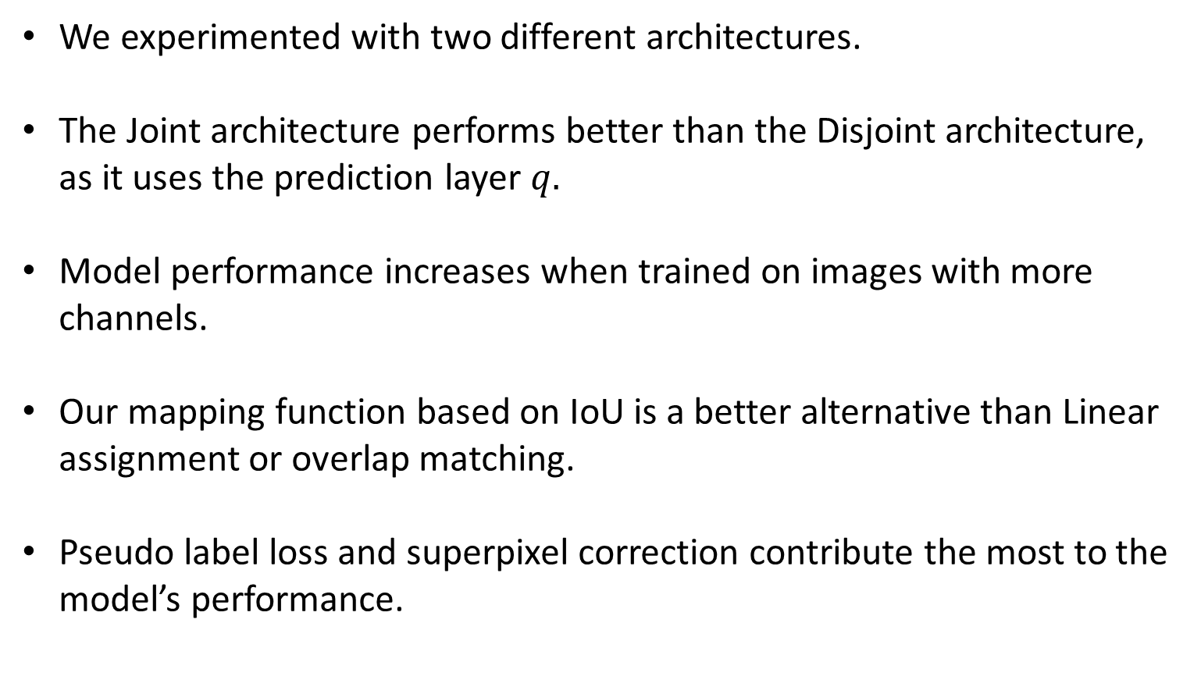
Conclusion
We experimented with two different architectures.
The Joint architecture performs better than the Disjoint architecture, as it uses the prediction layer $q.$
Model performance increases when trained on images with more channels.
Our mapping function based on IoU is a better alternative than Linear assignment or overlap matching.
Pseudo label loss and superpixel correction contribute the most to the model’s performance.
Notes:
Our work aimed to create a model that performed unsupervised image segmentation. We experimented with two different architectures.

Slide 37
Future Work
Use Linear classifier probing to evaluate the quality of representations learned by our model.
A pretrained Vision Transformers(ViT) can be used as backbone in our method.
Using larger datasets for training like WorldView-3 dataset by Spacenet.
Using domain adaptation techniques to transfer learned features to a different dataset.
Notes:
It involves training a linear classifier on top of the hidden representations extracted from intermediate layers of the network, and then evaluating the classifier's performance on a specific task.In our meth we used FCN instead we can use A pretrained Vision Transformers(ViT) .larger datasets will have more information for training.

Slide 38
THANK YOU

